Slide 1
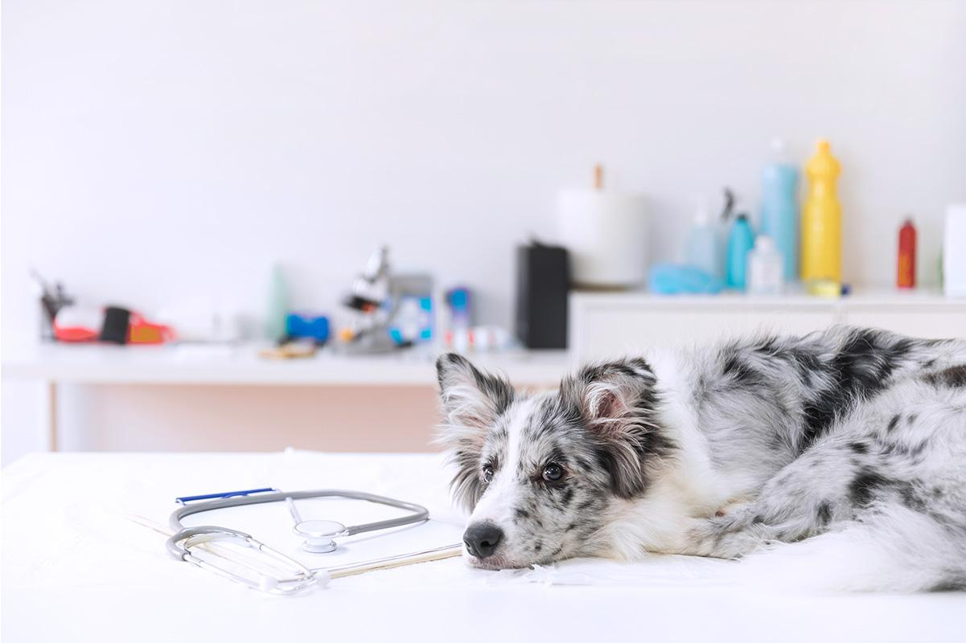
Post-Pandemic Puppers
Forecasting Animal Shelter Activity at Austin Animal Center
The Aggregators

Slide 2
TABLE OF CONTENTS
1
2
3
4
Background and Context
EDA
Modeling
Recommendations

Slide 3

Background
and
Context

Slide 4
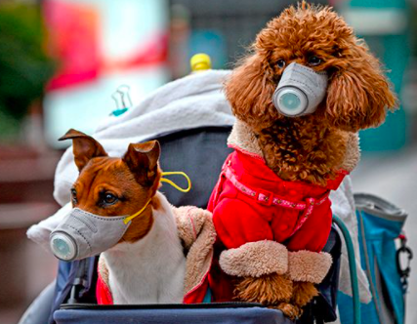
Adoption surges during COVID-19 lockdown
"Our appointment links are booked within one or two minutes every day. In the past, longer-term shelter animals used to stay for months. Now, even adult cats, which were previously difficult to get out the door, are snapped up by eager adopters. And some dogs and cats are lasting hours. Hours on the adoption floor."
-Sacramento Animal Shelter, March 2021.
The dogs and cats of the world are working overtime to keep our stress lower in pandemic!
Notes:
So many pets have been adopted during the pandemic that shelters are running out. Animal shelters are experiencing a unique problem: As the coronavirus pandemic has kept more residents at home, it has created such a high demand for adopting dogs and cats that the supply is increasingly limited.
Link to the article: https://www.abc10.com/article/news/local/sacramento/local-animal-shelters-pandemic-positive/103-debcc7d2-d711-40e6-9abb-87ef76d58a31

Slide 5
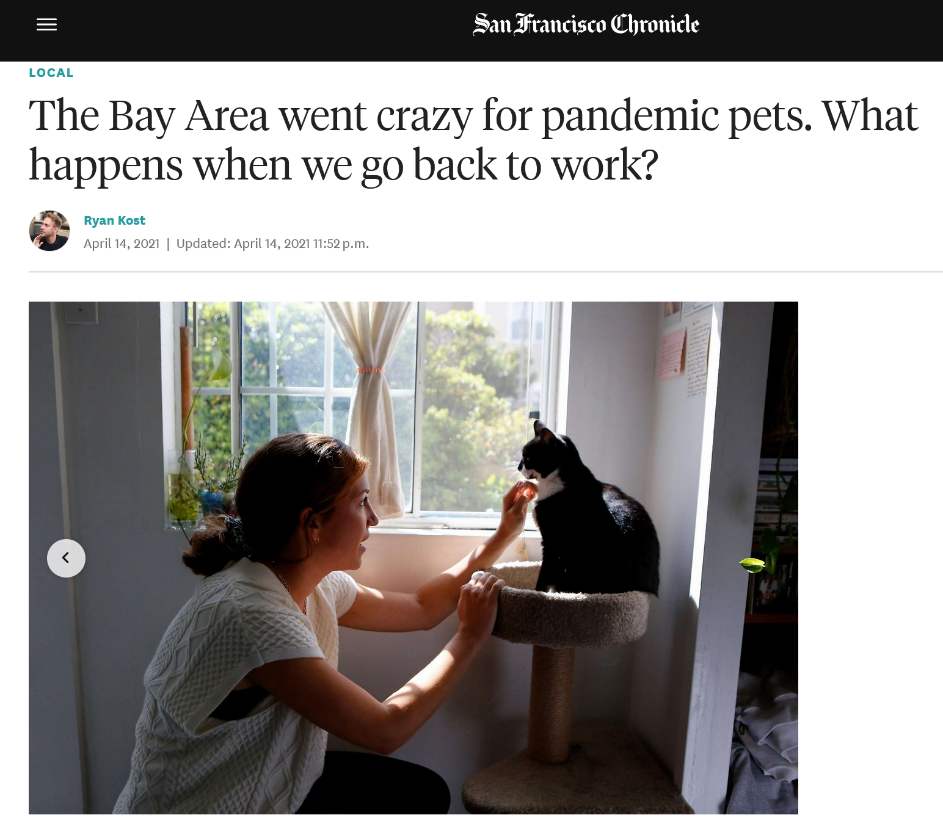
On the other hand, as owners return to work, they must learn to cope with leaving animals at home, and possible separation anxiety.
*Source: San Francisco Chronicle
Notes:
While the adoption boom has been a blessing for new pet owners, saved animals, and shelters, the question of what happens to these animals after people return to work still looms. Link: https://www.sfchronicle.com/local/article/The-Bay-Area-went-crazy-for-pandemic-pets-What-16098575.php?utm_source=newsletter&utm_medium=email&utm_content=briefing&utm_campaign=sfc_baybriefing_am&sid=5beb0817cac67b0a4039df1e#photo-20863484

Slide 6

Goals of our analysis
Visualize changes in adoption and intake during the pandemic
Use prediction to forecast expected trends
Recommend preparation to shelters based findings
Case Study:
Austin Animal Center

Slide 7
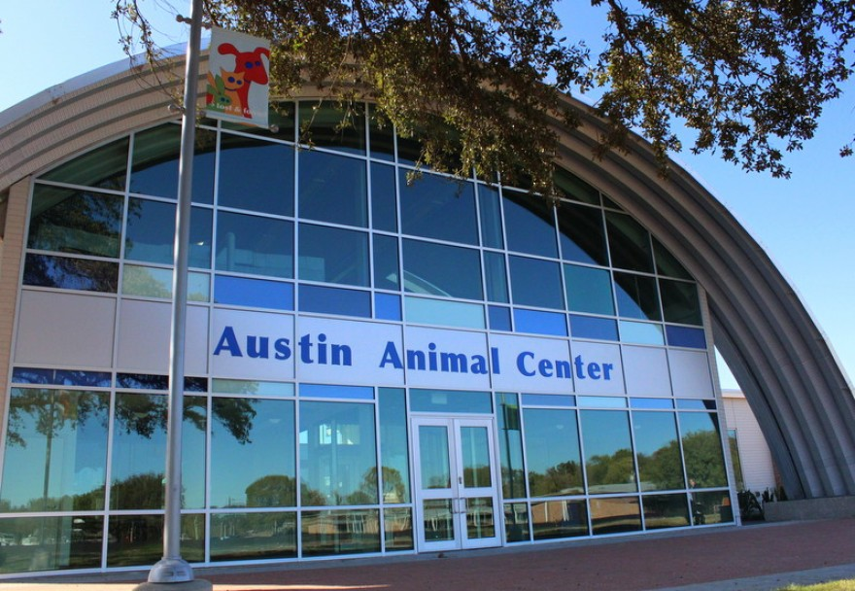
Our Data Source
From https://data.austintexas.gov
Animal intake and outcomes from 2013 - present
Dataset has inspired many data science projects on the web
Notes:
Describe AAC here

Slide 8
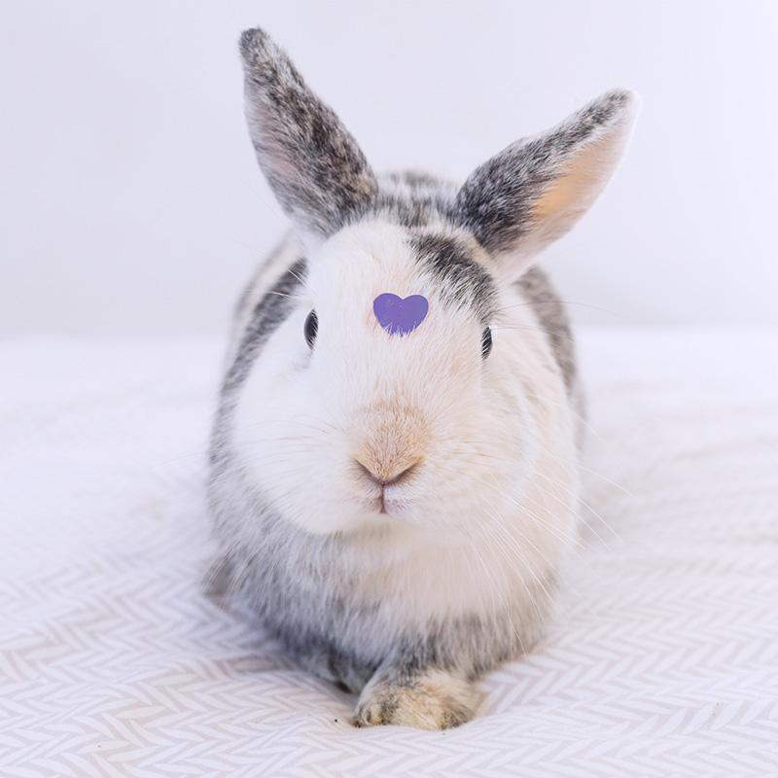
Exploratory
Data
Analysis

Slide 9

Definitions
Intake
Outcome
Adoption
Surrender
Transfer
Live Release Rate
an animal enters the shelter, such as through transfer, stray capture, or surrender.
the result of an animal’s stay, which includes adoption, transfer, euthanasia, or return to owner.
the animal has found a forever home!
the owner can no longer care for their animal and gives it to the shelter.
movement of care of an animal between two shelters.
% of animals entering the shelter who left the shelter alive (adoption, returned to owner, transfer to another shelter)
Notes:
Here are some definitions to clarify before moving on with shelter terminology.

Slide 10
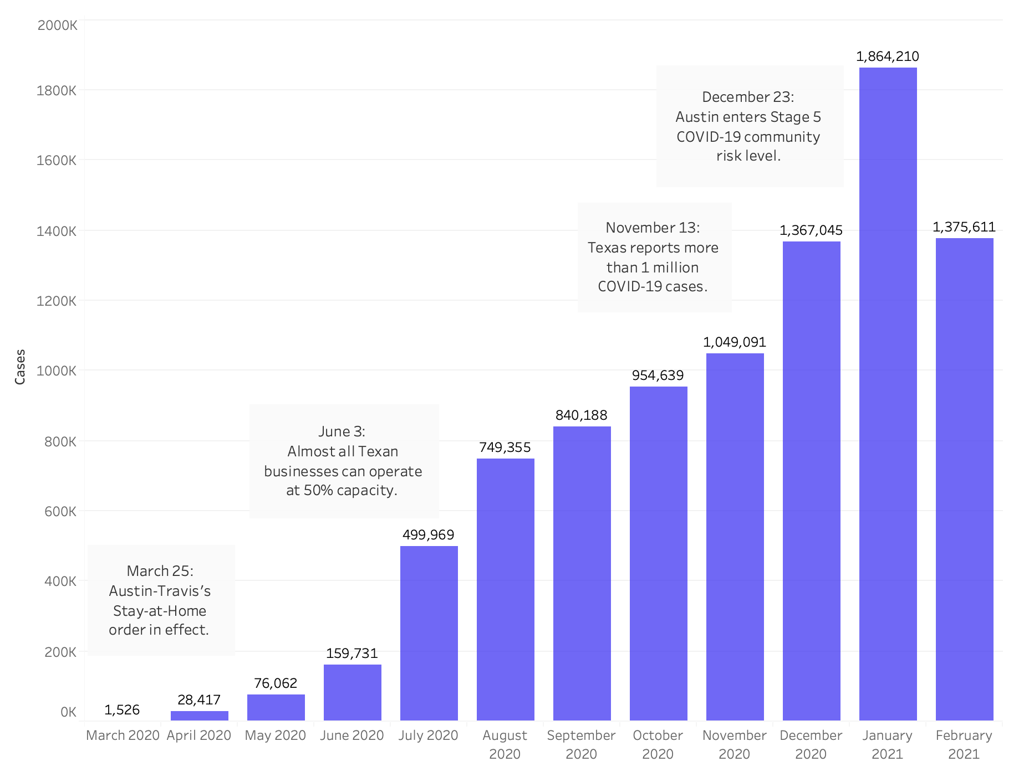
COVID-19 cases in Austin-Travis County, Texas, from March 2020 until February 2021.
Notes:
Austin-Travis County saw a steady increase in COVID-19 cases since March 2020, despite stay-at-home orders. Businesses were forced to shutter temporarily in early 2020, which affected the Austin Animal Shelter as well.

Slide 11
A Timeline of COVID-19 Shelter Policies
March 16, 2020
June 1, 2020
The AAC closed to the public. All services, except for emergency services, are suspended.
Most services made available by appointment, including adoptions, and found-pet intakes.
May 8, 2020
The AAC resumes intake and other services.
Notes:
On March 16, the AAC announced that it would close on March 16, 2020. Soon after, on March 25, the stay at home order came into effect, which meant losing all of its 500 participating volunteers. The center also did not take any new animals into the facility, and encouraged the community to help facilitate bringing lost animals back to their owners. Other emergency services for cases related to rabies quarantine, bite investigations, and injured animals are still offered.
On May 8, the AAC began offering adoption of dogs to the general public with appointment-only curbside meet and greets at the Austin Animal Center. Intake began again around this time as well, and other services started to become available by appointment only.

Slide 12
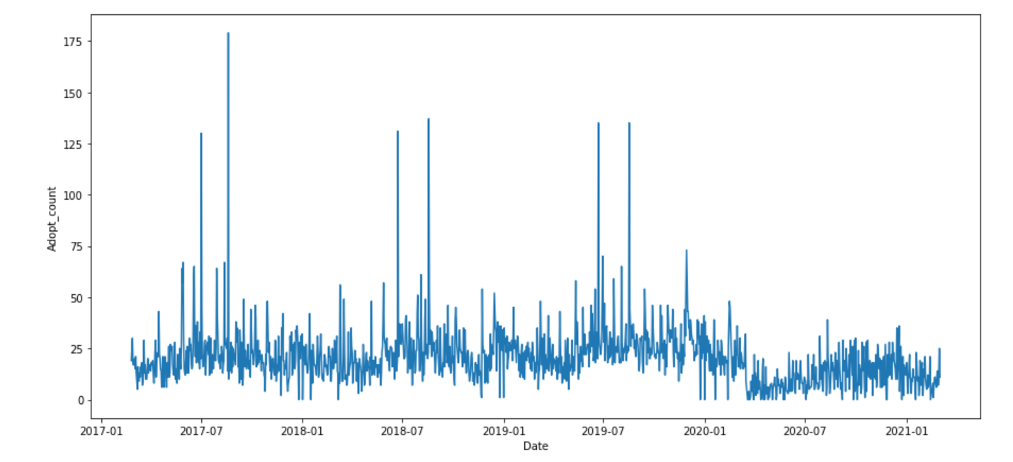
Adoptions continued in 2020, but with less volume than historical numbers
Notes:
60% less

Slide 13
Seasonal spikes in adoption prevented by lockdown
Adoption & Foster events usually take place in the summertime.
During COVID-19, there were only virtual events and limited walk-in adoption opportunities.
Notes:
The AAC often holds big adoption / foster events in the summertime months (June - August). This is from their IG posts:
Kitty Palooza (June 22, 2019; June 23, 2018; July 1-2, 2017)
Hula Hounds ($20 adoptions) (June 9 - 12, 2017)
During the pandemic, these events were either cancelled or became virtual. In the summer of 2020, there were some socially-distanced adoption and foster events that were had both walk-in and appointment options. This still drew significantly fewer people to the center, compared with numbers prior to the pandemic.
While it is obvious that the pandemic had an effect on adoptions, and clear that adoptions bounced back, it is not clear that there was a large spike in adoptions.

Slide 14
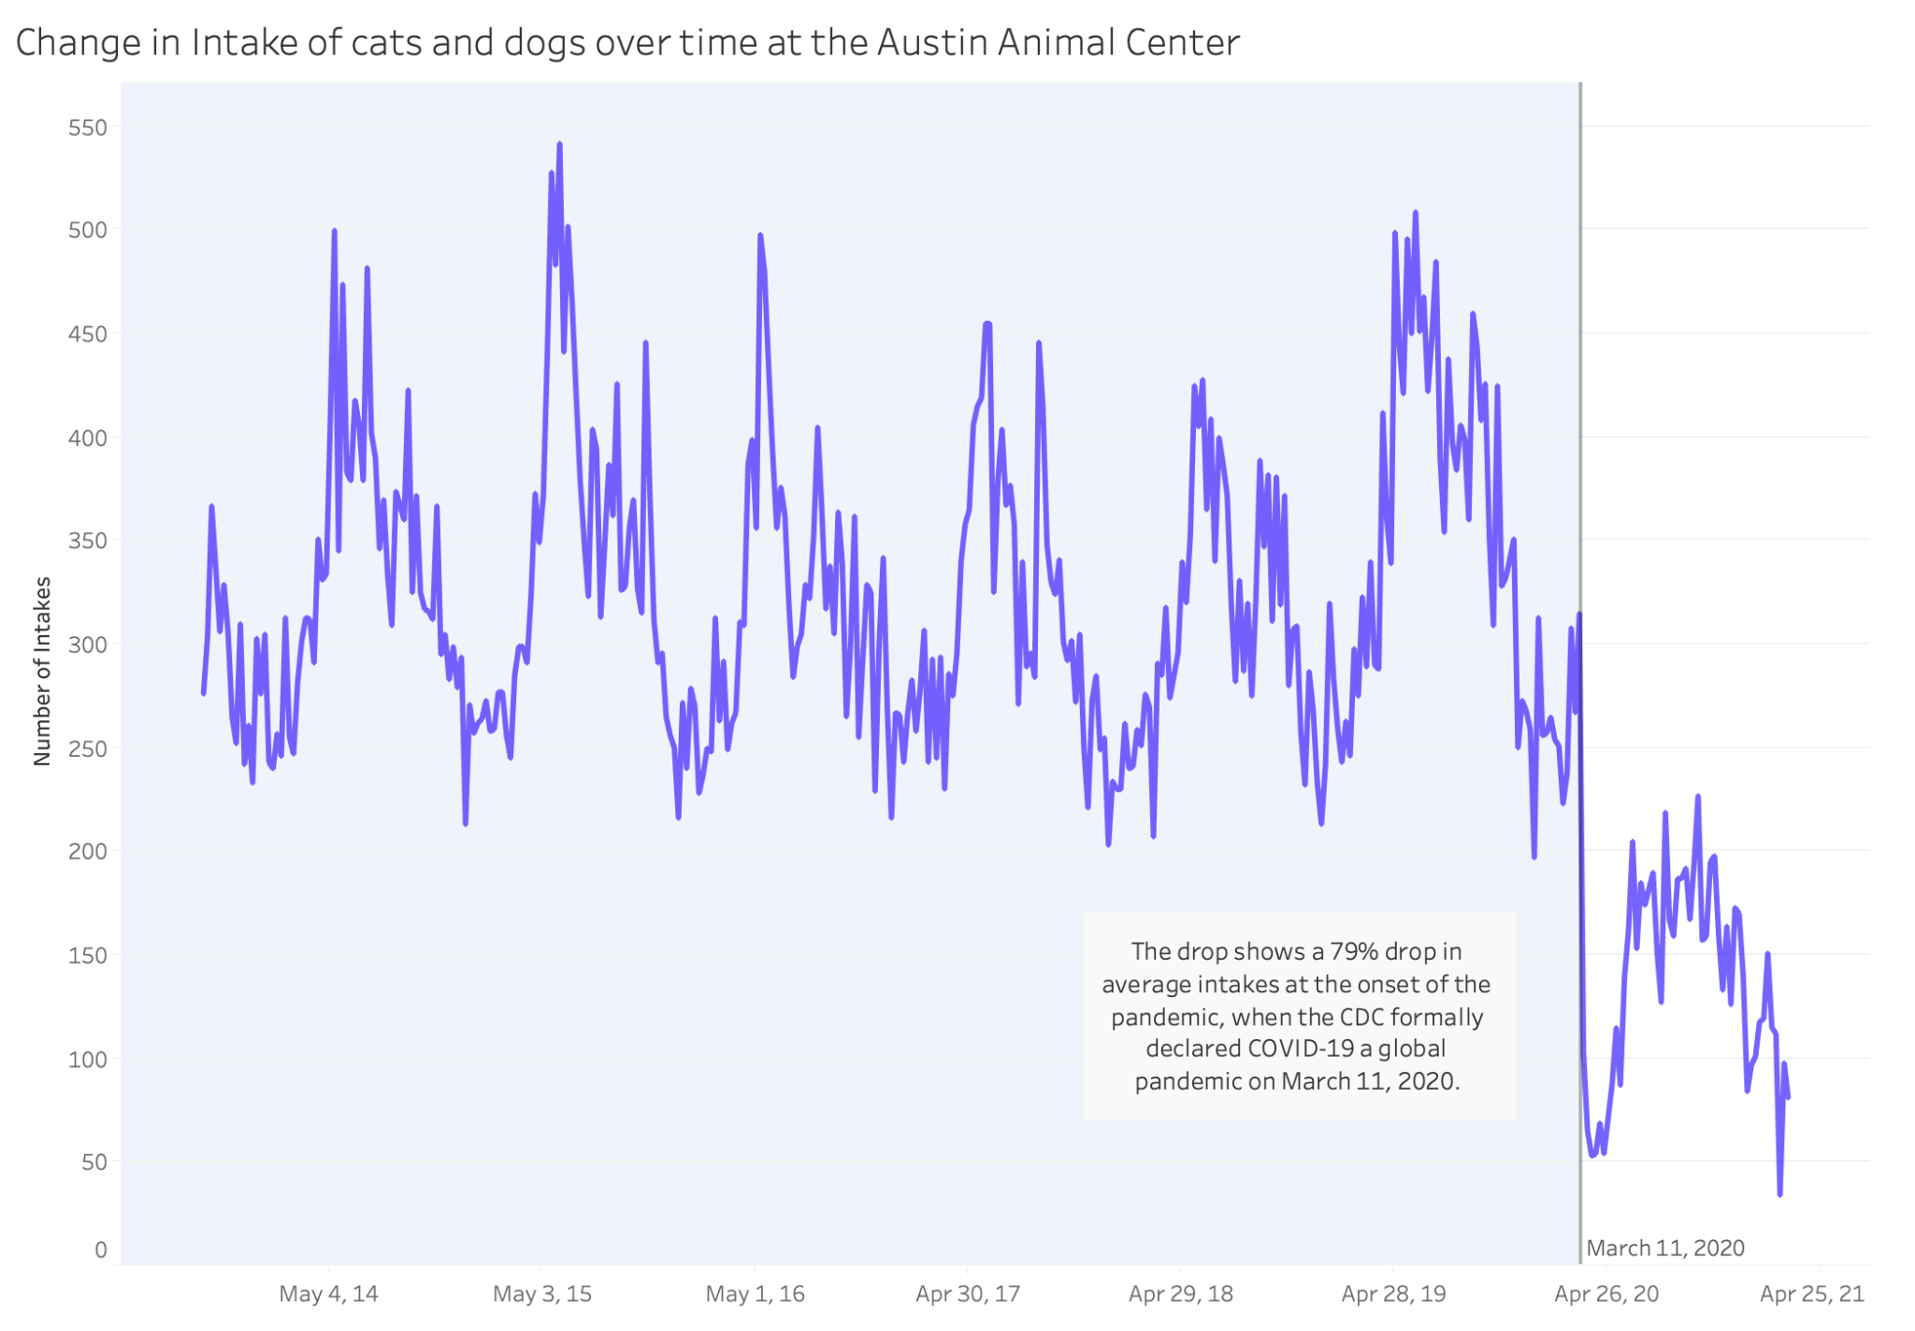
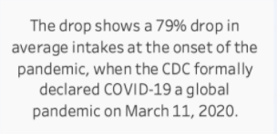
Intake of Cats and Dogs at the AAC since 2014.
Notes:
Along with the decrease in adoption rates, intake has dropped as well at the the onset of the COVID-19 in Austin.
This is due to the fact that the AAC stopped taking in animals from mid March to May, and implemented more safety restrictions once intake became available again.

Slide 15
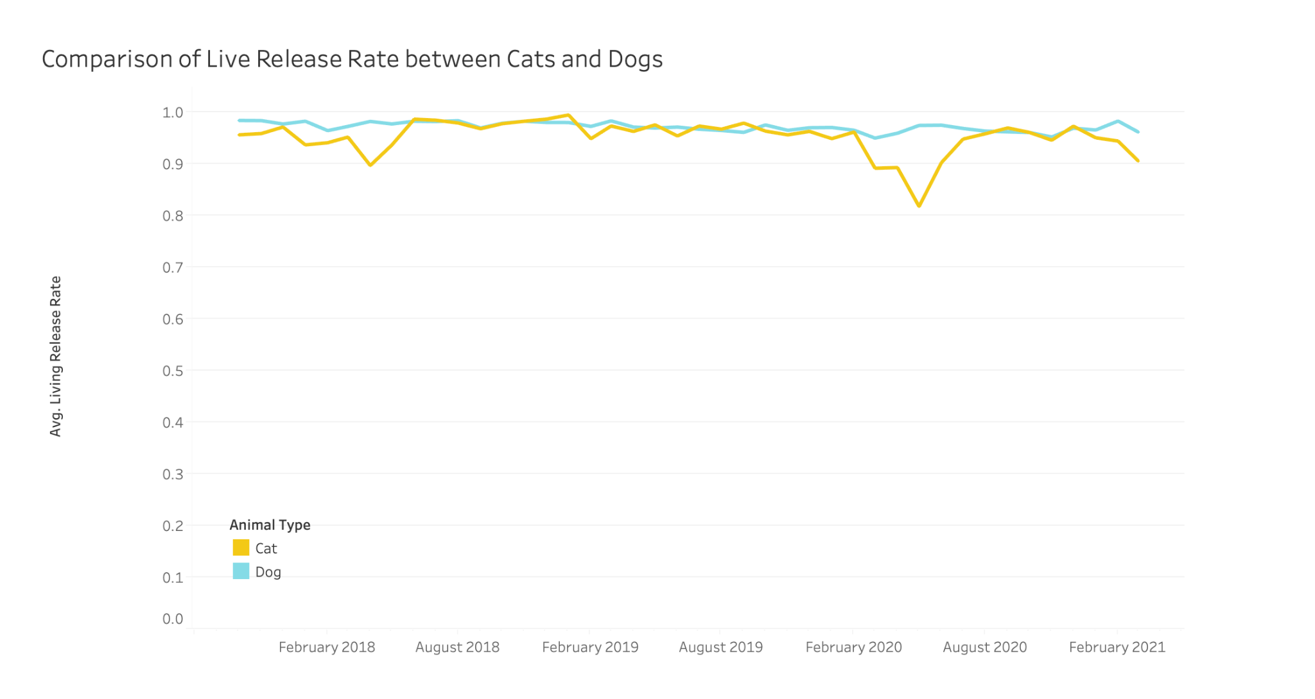
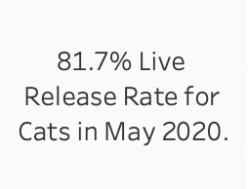
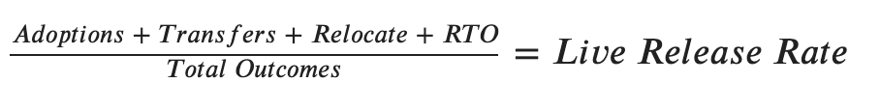
Comparison of Live Release Rates* between Cats and Dogs since 2018.
*For our analysis, we have defined Live Release Rate as such:
Notes:
We decided to look at a metric that is commonly used in the industry -- the Asilomar Live Release Rate, which is the proportion of Live Outcomes over Total Outcomes. (whereby Live outcomes would include adoptions, transfers, relocations, or return to owner). The Live Release Rate tells us what the % of animals (with an outcome) left the facility with a Live Outcome (adoption, return to owner, etc), as opposed to death, euthanasia, etc.
The higher the live release rates, the better, and the Austin Animal center has been maintaining a high LRR so far. In fact, Austin Animal Center runs the largest no-kill animal shelter in the United States, providing shelter to more than 18,000 animals each year and animal protection services to all of Austin and Travis County.
We compared the LRR for cats and dogs at the AAC since 2018, and we noticed a dip in LRR for Cats in May 2020. We hypothesized that this may have to do with either 1) Decreased intake in Cats, or 2) decreased live outcomes in cats in May 2020.

Slide 16
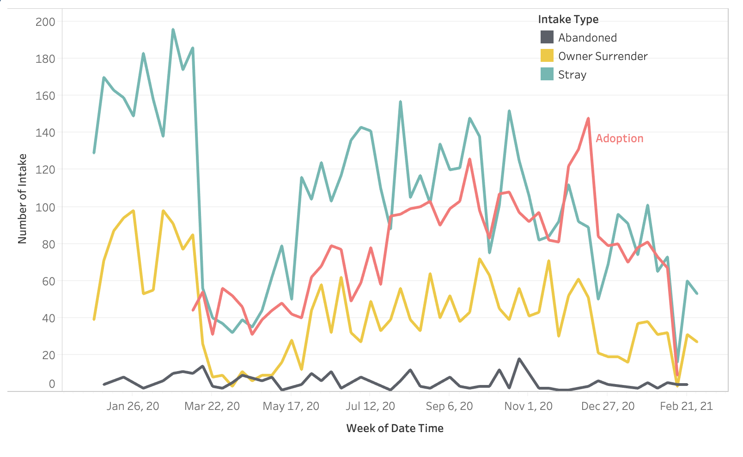
Number of intakes across different intake types for cats and dogs since 2020.
Notes:
Strays and owner surrender make up the most common intake types overall. Notably, Strays and Owner Surrenders plummeted in March (likely due to the change in shelter policies on intakes). The other intake categories remain relatively constant.
This drop in intake numbers contradicted our hypothesis: with 1) the shelter eventually resuming intake operations around May (as seen in the jump around that time) and 2) our qualitative studies led us to believe that there will be higher intake due to the pandemic forcing some owners out of jobs and homes and needing to give up their pets. This led to the question: if the shelter isn’t taking them in, where are these animals going?

Slide 17
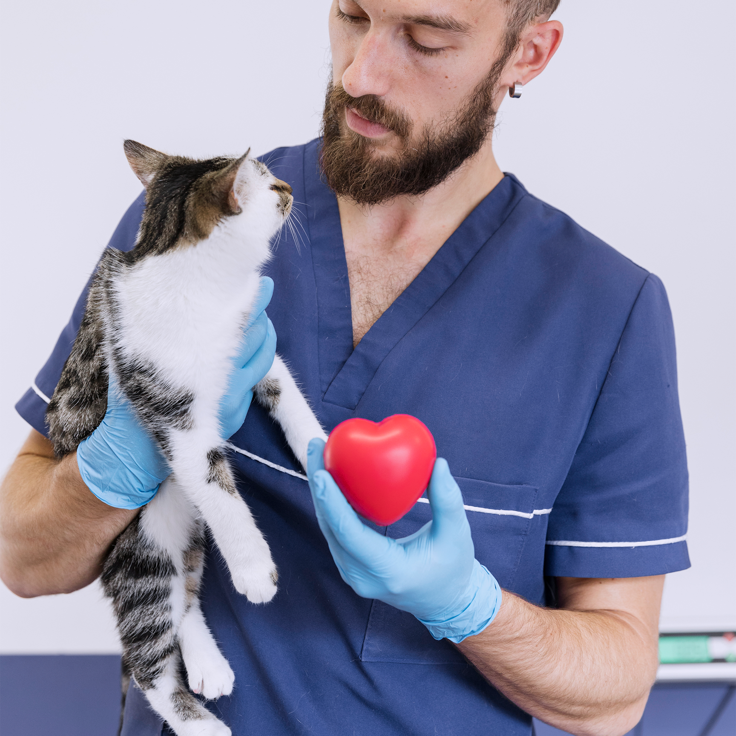
Time Series Modeling

Slide 18
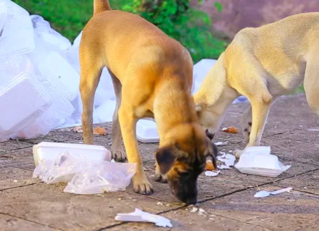
Hypothesis: Increased Demand == Increased Intake ?
Total Intake in US
-35%
840,750*
548,966*
Mar-Jun’19
Mar-Jun’20
Early increases in adoption coupled with sustained decreases in intake resulted in an improved live release rate for homeless animals nationwide.
To put this in better context—tens of thousands fewer homeless dogs and cats lost their lives or are on the streets across the country this spring compared to last.
Thousands of homeless dogs and cats lost their lives in COVID-19
*Source: Shelter Animals Count (a national database of sheltered animal statistics)
Notes:
Early increases in adoption coupled with sustained decreases in intake resulted in an improved live release rate for homeless animals nationwide. According to the same Covid-19 Impact Report from Shelter Animals Count, 89 percent of homeless dogs and cats left shelters alive from March through June 2020 compared to 86 percent during the same period in 2019. To put this in better context—tens of thousands fewer homeless dogs and cats lost their lives across the country this spring compared to last.

Slide 19
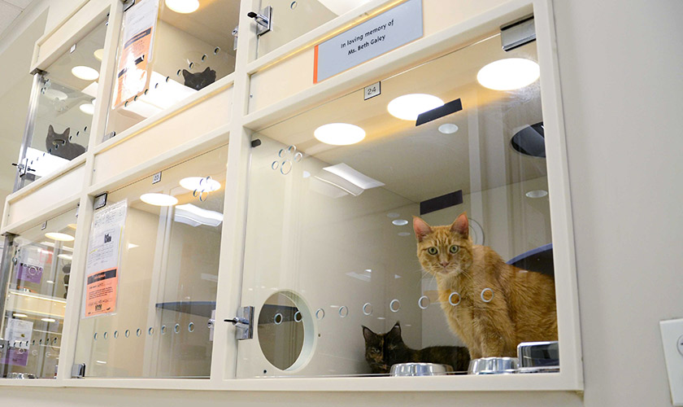
Modeling Expected Intake
Can we use time series modeling to forecast the expected intake level during the pandemic period, if activities were not affected by COVID-19?
Notes:
Given the previous information on decreased intake, increased demand for pets, and need for some owners to give up their long-time pets, we would expect intake to increase at the shelter. However, due to restrictions and capacity constraints, this was unable to happen. We want to visualize what intake would have looked like under normal conditions in the pandemic period and compare that with actual intake.

Slide 20

Methodology
Train ARIMA model on pre-pandemic intake data
Forecast intake from beginning of the shelter closure to this year (3/16/2020 - 3/15/2021)
Observe the difference between expected intake and actual intake
1
3
2

Slide 21
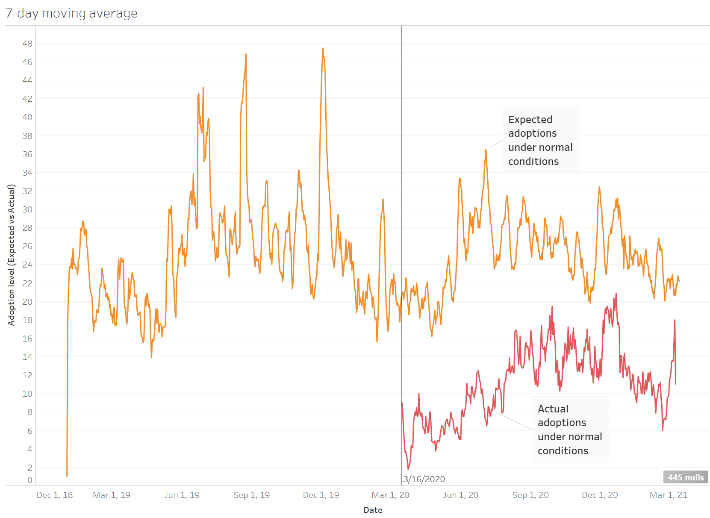
Adoptions are seemingly catching up with expected levels in later period of the pandemic
Notes:
Compared with the orange line in this graph, representing expected adoptions under normal conditions, adoptions did take a hit but appear to be closing the gap in the later months of the pandemic

Slide 22
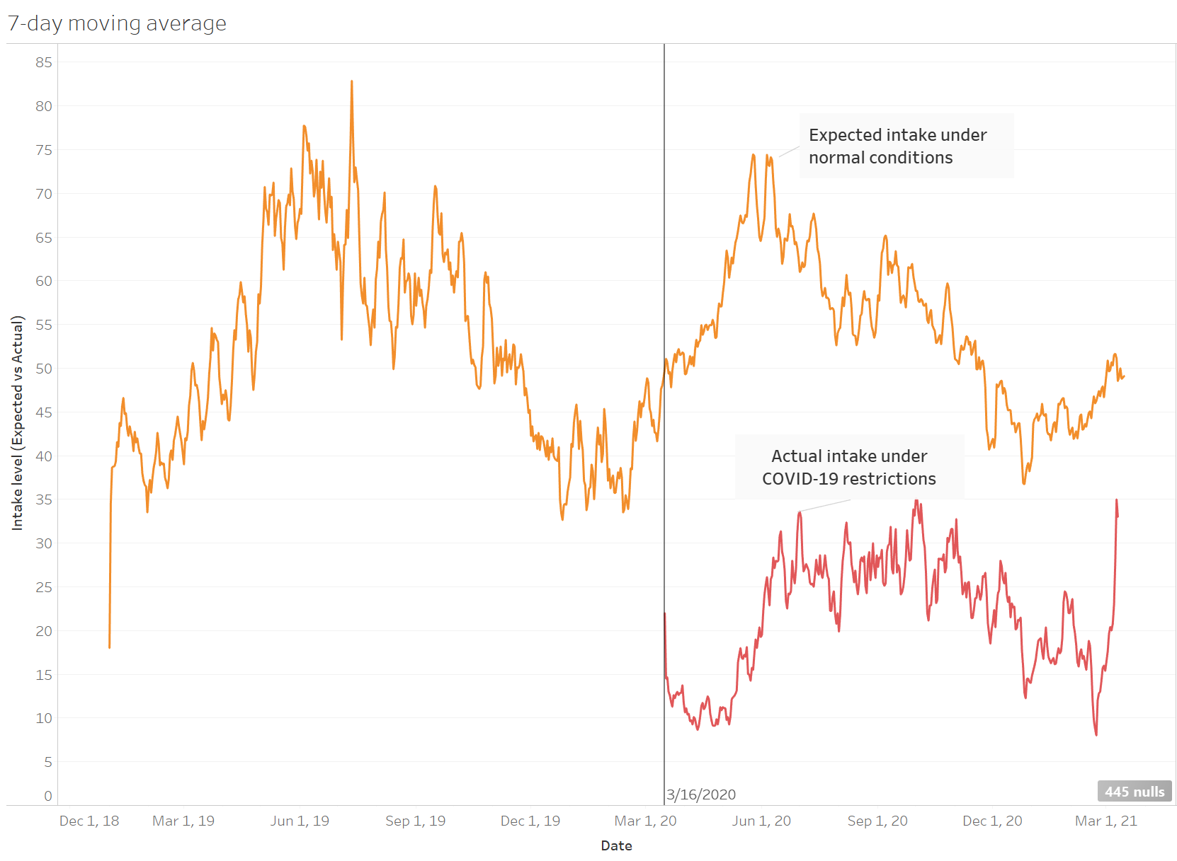
Actual intake was about half of normal expectations
Recent intake almost catches up to forecasted levels, as delineated by the steep, upward trajectory.
Notes:
Unlike adoptions, intake is taking a longer time to catch up with expectations. Note that gap is quite large and this isn’t even accounting for the animals that had to be given up by petowners who lost jobs or homes. Without more intake, more adoptions cannot occur.

Slide 23
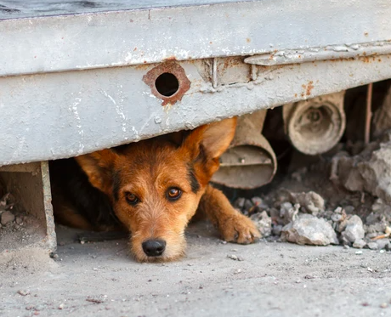
COVID-19 Impacted Intake!
Limited staff at shelters
Stray animals taken on case-by-case basis
Shelters temporarily stopped taking in
Owner-surrendered animals
Owners requesting euthanasia for their pet
Belief that COVID-19 can be transmitted amongst animals
Notes:
Shelters are not able to open with 100% staff capacity because of COVID. Some people also fear that animals can also contract COVID than transmit to humans. Because of this reason and the intent to keep up their live release rates high, shelters are taking in limited number of stray and owner surrendered animals. This has contributed to very low intake in the shelters eventually leading to many animals on the streets and death.

Slide 24
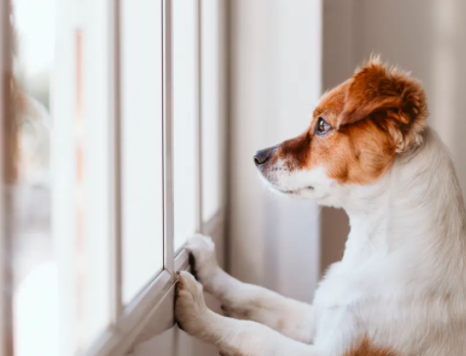
On the other hand…
Pet surrenders becoming tragic part of pandemic
In Aug’20, the American Society for the Prevention of Cruelty to Animals released data estimating that 4.2 million pets will enter poverty in the next six months as a result of the COVID-19 crisis, a 21% increase from pre-pandemic estimates.
The total number of animals living in poverty could rise to more than 24.4 million dogs, cats, horses and other animals.
Countless animals are surrendered/abandoned
by the owners and are on the streets
devoid of food and shelter
Main Reason:
Economic hardships faced by people in the pandemic!
Notes:
In Aug’20, the American Society for the Prevention of Cruelty to Animals released data estimating that 4.2 million pets will enter poverty in the next six months as a result of the COVID-19 crisis, a 21% increase from pre-pandemic estimates. The total number of animals living in poverty could rise to more than 24.4 million dogs, cats, horses and other animals. This means there are so many animals right now on the streets! This is mainly because countless people have lost their jobs and livelihood.

Slide 25

Our Recommendation for shelters:
INCREASE SHELTER INTAKE
But how can we do that?
Notes:
Based on our analysis, one main recommendation that we want to give for Austin Animal Shelter, as well all other Animal Shelters in similar situations, is to increase the intake volume. Last month, the ASPCA ® (The American Society for the Prevention of Cruelty to Animals) launched a Relief & Recovery Initiative grantingf $2 million in grants to animal welfare organizations. This will help strays and owners who must give up their pets due to the pandemic. By increasing intake and adoptions, we increase the live release rate. To effectively take in more animals, we would like like to offer solutions:

Slide 26
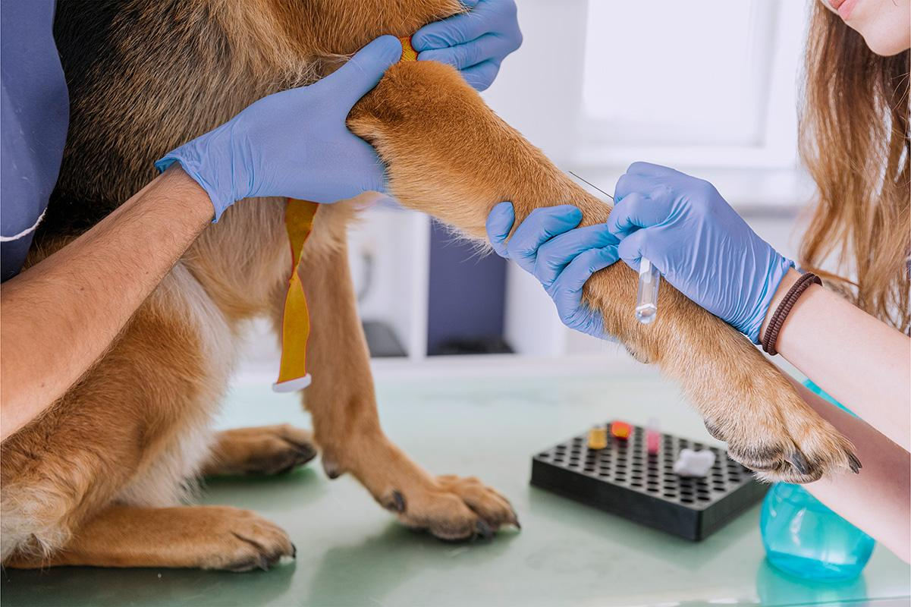
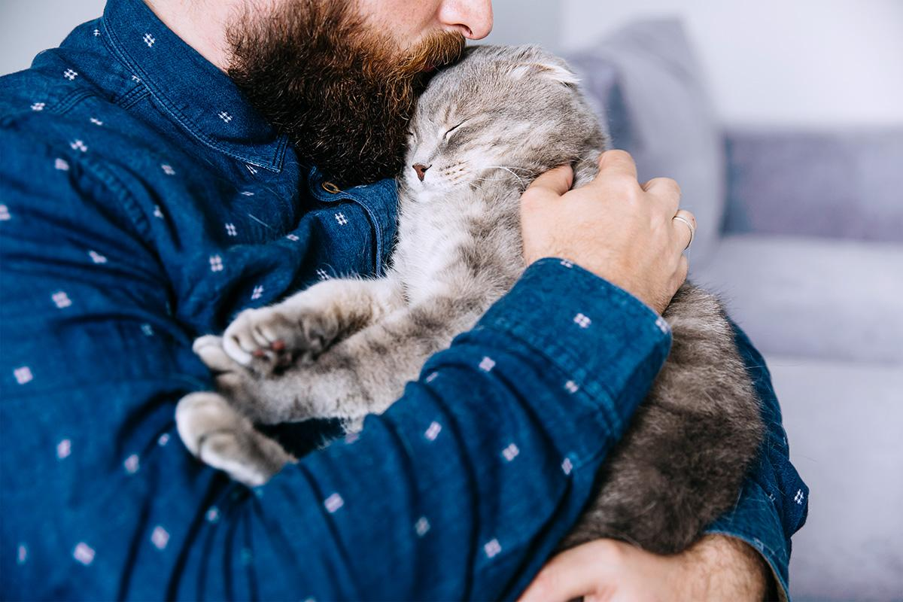
More Volunteers
Expand Capacity
Encourage more volunteers as the COVID vaccine rollout
Higher caregiver-to-animal ratio for improved life quality
Scale up the infrastructure based on seasonal trends
Recruit more foster owners to dilute intake overflow
Notes:
The first one will be recruiting more volunteers. Volunteers are one of the major staff sources for most animal shelters nationwide. During COVID, the sheltering at home order and as health concern, decrease in volunteering might be one reason that the lower shelter intake in the past year. However, as the COVID vaccines continues to rollout, 55% percent of Travis county had at least one doses and 23% are fully vaccinated. We believe the volunteer resource will go back to pre-covid level in a foreseeable future.
Another solution to increase intake is to increase the shelter capacity. By scaling up the infrastructures and spaces, the shelter will be able to take care of animals with resource concern, and larger spaces may also reduce the probability of cross infections of diseases between shelter animals, which in turn may increase the living rate. They can also use community resources such as foster home programs to better allocate the resources according to the seasonal peaks and lows.

Slide 27
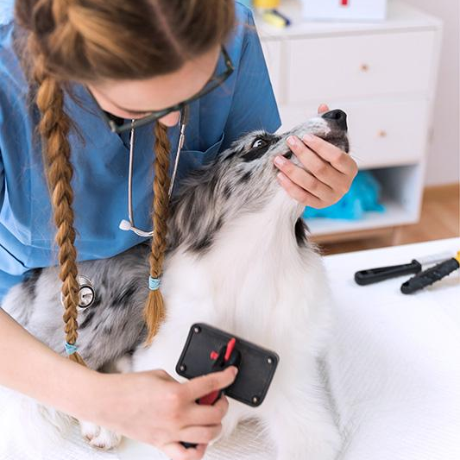
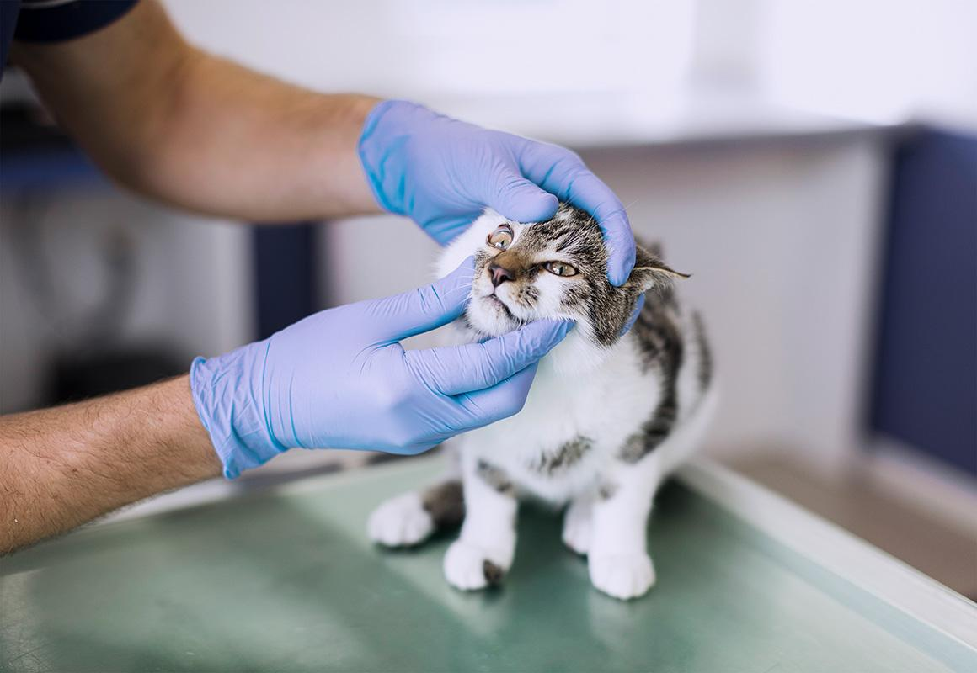
Adoptions Go Virtual
Surrender Support Kit
Host virtual summer adoption events during surge season
Remote adoption system
Provide instructions and help to struggling pet owners
Incentivize options for surrender before abandonment
Notes:
The third recommendation we would like to offer is to take advantage of the rapidly developed online meeting system to virtualize the adoption process. For example, the shelter can host online summer adoption sessions to attract more attention to the animals and adoption options. Or even set up a remote adoption system. Many people who are passionate about adopting animals might have physical or environmental concerns that stopped them. With remote adoption, they can take care of the animals through sponsorship and live-watch their adopted pet through monitor camera.
The last recommendation will be handing out surrender support kit for those owners who are struggling with keeping their pets. Give them resources to keep them, or otherwise inform them that they can surrender their pet to the shelter instead of abandoning them. As indicated in our analysis, surrendered pets usually have higher adoption possibilities than abandoned intakes.

Slide 28
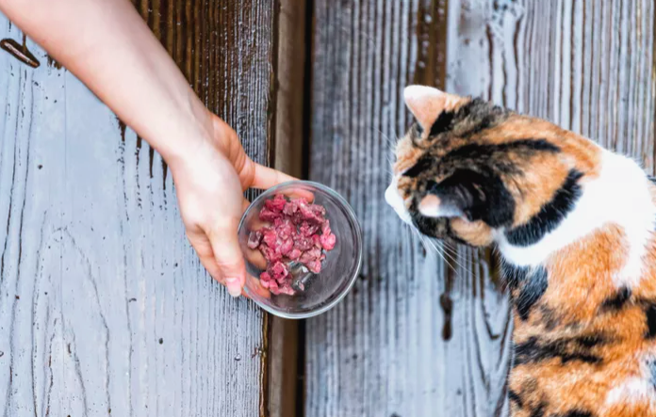
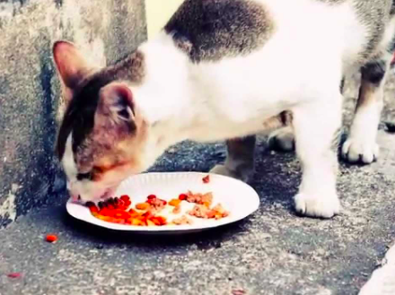
Last but not the least
Social Responsibility
Encouraging the community to tend to animals in need until shelters resumes with normal capacity and owners are able to take back their surrendered pets
Provide guidance to the community for managing stray colonies, form a catch-and-release spay and neuter program
Small actions can collectively make a huge difference!
Notes:
We can collectively take some responsibility to look after our community. Animals are very essential to our community. Until shelters resume at normal capacity and owners are on their feet, we can look after the animals in our neighborhood by providing food and care. Small actions can collectively make a huge difference in the society!

Slide 29
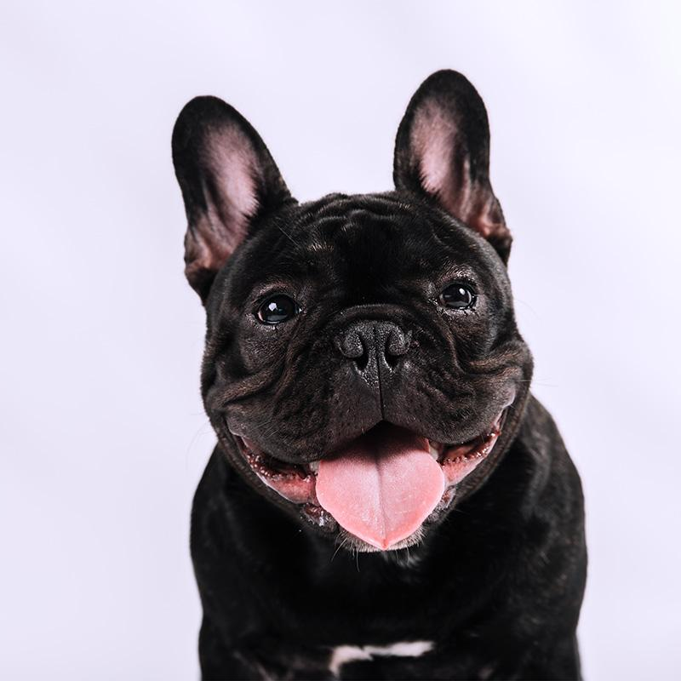
THANK YOU!
Notes:
Thank you for watching our presentation!
Below are a few resources that can help support animal shelters around the bay area:
SF Animal Care & Control: https://www.sfanimalcare.org/
SF SPCA: https://www.sfspca.org/
Berkeley Humane: https://berkeleyhumane.org/
Peninsula Humane Society and SPCA: https://phs-spca.org/

Slide 30
REFERENCES
Texas Vaccine Rollout Information https://www.kxan.com/texas-coronavirus-vaccine/maps-how-many-people-are-fully-vaccinated-against-covid-19-in-your-zip-code/
ASPCA COVID-19 Relief & Recovery Initiative https://www.aspca.org/about-us/press-releases/aspca-commits-5-million-covid-19-relief-recovery-initiative-help-animal
How local animal shelters successfully navigated the pandemic https://www.abc10.com/article/news/local/sacramento/local-animal-shelters-pandemic-positive/103-debcc7d2-d711-40e6-9abb-87ef76d58a31
The Bay Area went crazy for pandemic Pets https://www.sfchronicle.com/local/article/The-Bay-Area-went-crazy-for-pandemic-pets-What-16098575.php?utm_source=newsletter&utm_medium=email&utm_content=briefing&utm_campaign=sfc_baybriefing_am&sid=5beb0817cac67b0a4039df1e#photo-20863484

